Slide 1
Chapter 2

Slide 2
Objectives

Slide 3
Objectives (continued)

Slide 4
Two attributes of the script element

Slide 5
A script element that embeds JavaScript in the head section

Slide 6
Terms

Slide 7
JavaScript in the body of an HTML document

Slide 8

The result of the JavaScript in a web browser

Slide 9
A noscript element in the body of an HTML document

Slide 10
A noscript element at the start of an HTML document

Slide 11
A block of JavaScript code

Slide 12
The basic syntax rules for JavaScript

Slide 13
How to split a statement over two or more lines

Slide 14
Rules for creating identifiers

Slide 15
Valid identifiers in JavaScript

Slide 16
Camel casing versus underscore notation

Slide 17
Naming recommendations for identifiers

Slide 18
JavaScript code with the comments highlighted

Slide 19
The basic syntax rules for comments

Slide 20
Terms

Slide 21
JavaScript’s primitive data types

Slide 22
Examples of number values

Slide 23
Examples of string values

Slide 24
The two Boolean values

Slide 25
How to declare and assign a value to a variable in two statements

Slide 26
How to declare and assign a value to a variable in one statement

Slide 27
Terms

Slide 28
JavaScript’s arithmetic operators

Slide 29
The order of precedence for arithmetic expressions

Slide 30
Examples of simple arithmetic expressions

Slide 31
Code that calculates sales tax

Slide 32
The most useful compound assignment operators

Slide 33
Three ways to increment a counter variable by 1

Slide 34
A floating-point result that isn’t precise

Slide 35
Terms related to arithmetic expressions

Slide 36
The concatenation operators for strings

Slide 37
How to concatenate a string and a number with the + operator

Slide 38
Some of the escape sequences that can be used in strings

Slide 39
Terms related to strings

Slide 40
Common methods of the window object

Slide 41
A statement that calls the prompt() method with the object name omitted

Slide 42
One property of the window object

Slide 43
Two methods of the window object

Slide 44
Examples that use the parseInt() and parseFloat() methods

Slide 45
The same examples with the parse methods embedded in the alert() method

Slide 46
Two methods of the document object

Slide 47
Examples of the write() and writeln() methods

Slide 48
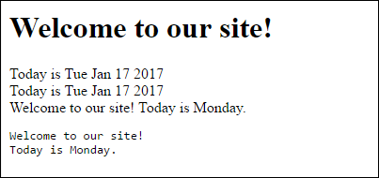
The output in a browser

Slide 49
Terms related to objects

Slide 50
The Calculate MPG application

Slide 51
The Calculate MPG application (continued)

Slide 52
The HTML and JavaScript for the application

Slide 53
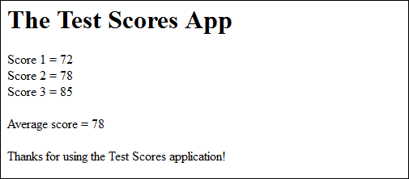
The results of the Test Scores application in a browser

Slide 54
The HTML and JavaScript for the application

Slide 55
The HTML and JavaScript (cont.)

Slide 56
Exercise 2-1 Modify the MPG application

Slide 57
Exercise 2-3 Create a simple application

Slide 58
Extra 2-1 Convert Fahrenheit to Celsius

Slide 59
Short 2-1 Modify the Test Scores application

